Slide 1
Week 12

Slide 2
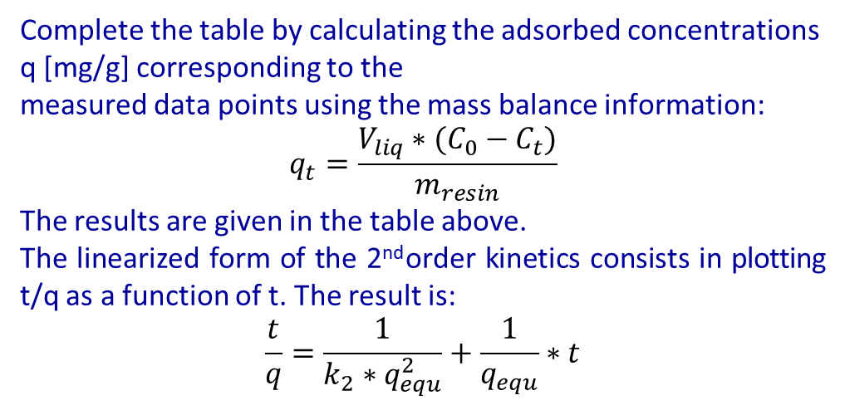
Exercise 4.1 – Adsorption kinetics
20 ml of an antibiotic solution with initial concentration C0 = 30.0 mg/ml were contacted with 2.5 g of an adsorption resin. The evolution of the solute concentration in the liquid phase was measured as a function of contacting time. The results are given in the table below.
Assuming the kinetics is of the second order, determine the adsorption rate constant k2 and the equilibrium concentration q equ. Please don’t forget to specify the units for these parameters.
t [min] | 0 | 2 | 5 | 10 | 18 | 30
C [mg/ml] | 30 | 24.4 | 20.4 | 17.4 | 15.4 | 14.1
q [mg/g]
t/q [min*g/mg]
t [min] | 0 | 2 | 5 | 10 | 18 | 30
C [mg/ml] | 30 | 24.4 | 20.4 | 17.4 | 15.4 | 14.1
q [mg/g] | 0 | 44.8 | 76.8 | 100.8 | 116.8 | 127.2
t/q [min*g/mg] |  | 0.0446 | 0.0651 | 0.0992 | 0.1541 | 0.2358
Complete the table by calculating the adsorbed concentrations q [mg/g] corresponding to the
measured data points using the mass balance information:
$$q_{t}=\frac{V_{liq}∗(C_{0}−C_{t})}{m_{resin}}$$
The results are given in the table above.
The linearized form of the 2nd order kinetics consists in plotting t/q as a function of t. The result is:
$$\frac{t}{q}=\frac{1}{k_{2}∗q_{equ}^{2}}+\frac{1}{q_{equ}}∗t$$
From the slope and intercept of the straight line, one gets:
q_{equ}=1/0.006832=146.37 [mg/g]
k₂ = 1.507·10⁻³ [g/(mg min)]

Slide 3
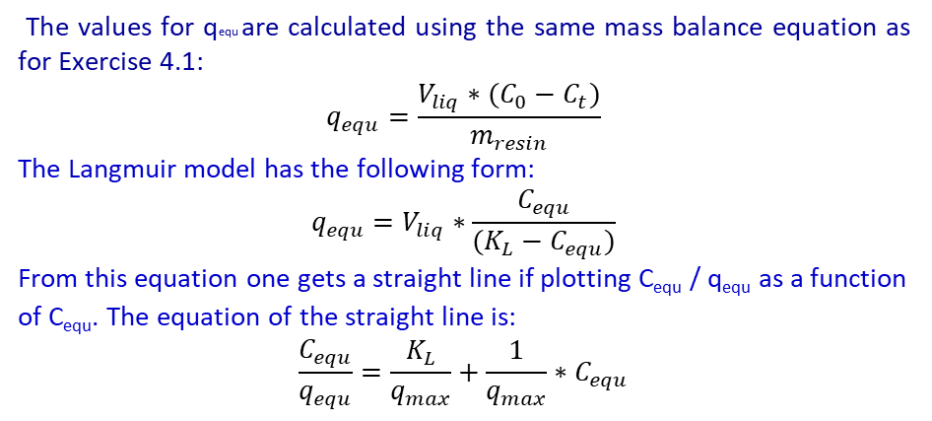
Exercise 4.2 – Adsorption isotherm
To characterize the adsorption isotherm of an antibiotic on a resin, 20 mL of antibiotic solutions with variable initial concentrations C0 were contacted with 2.5 g adsorbent.
The residual concentration Cequ was measured in the liquid phase once equilibrium was reached. The results are given in the table below. Also, use the result of Exercise 4.1 to complete the table.
Calculate the adsorbed concentrations at equilibrium q_{equ} and treat the data according to the Langmuir model to determine the parameters of the isotherm curve.
Hint: to linearize the Langmuir model, try plotting C_{equ}/q_{equ} as a function of C_{equ}. What do you obtain? How do you extract the parameters from the obtained slope and intercept?
C0 [mg/ml] | 0 | 10 | 20 | 30 | 40 | 50
Cequ [mg/ml] | 0 | 2.3 | 6 |  | 19 | 27.3
qequ [mg/g]
Cequ/qequ [g/ml]
C0 [mg/ml] | 0 | 10 | 20 | 30 | 40 | 50
Cequ [mg/ml] | 0 | 2.3 | 6 | 11.7 | 19 | 27.3
qequ [mg/g] |  |  |  | 146.4
Cequ/qequ [g/ml]
C0 [mg/ml] | 0 | 10 | 20 | 30 | 40 | 50
Cequ [mg/ml] | 0 | 2.3 | 6 | 11.7 | 19 | 27.3
qequ [mg/g] | 0 | 61.6 | 112 | 146.4 | 168 | 181.6
Cequ/qequ [g/ml] | / | 0.03734 | 0.05357 | 0.07992 | 0.1131 | 0.1503
The values for qequ are calculated using the same mass balance equation as for Exercise 4.1:
$$q_{equ}=\frac{V_{liq}∗(C_{0}−C_{t})}{m_{resin}}$$
The Langmuir model has the following form:
$$q_{equ}=V_{liq}∗\frac{C_{equ}}{(K_{L}−C_{equ})}$$
From this equation one gets a straight line if plotting C_{equ} / q_{equ} as a function of C_{equ}. The equation of the straight line is:
$$\frac{C_{equ}}{q_{equ}}=\frac{K_{L}}{q_{max}}+\frac{1}{q_{max}}∗C_{equ}$$
From the slope and intercept of the straight line, one gets:
q_{max} = (slope)⁻¹ = 220.6 [mg/g]
k_{L} = (intercept/slope) = 5.89 [mg/ml],

Slide 4
Exercice 4.3 - NPT and HEPT for a preparative column
A pulse injection was performed at time t=0 to determine the packing efficiency of a preparative chromatography column (diameter 5 cm, bed length 36 cm). The resulting peak is shown in the figure below.
Determine the number of theoretical plates NTP and the height equivalent to a theoretical plate HETP.
W _{0.5} as measured from the graph is ca. 3.7 min
Hence NEPT = 5.54·(t_{r}/W_{0.5})² = 364 plates
The peak width at its base W_{base} is around 6.4 min.
Hence NEPT = 16·(t_{r}/W_{base})2 = 352 plates
Based on these results, the height equivalent to a theoretical plate HETP is equal to the column length L divided by the number of plates N.
The result is 989 μm for the calculation with W _{0.5} and 1023 μm (or 1.023 mm) for the calculation with W_{base}
The retention time of the peak is clearly 30 min
To determine the number of theoretical plates one can use either the peak width at half height W _{0.5}, or the peak width at its base, W_{base}.
W _{0.5} as measured from the graph is ca. 3.7 min
The peak width at its base W_{base} is around 6.4 min.

